Slide 1

Wheel of Time
Sentiment Analysis
Santiago Torres
12/07/2021

Slide 2
Abstract
As an avid reader, The Wheel of Time is one of my favorite high fantasy series. After learning about sentiment analysis in the DATA607 class, I was inspired to apply sentiment analysis to the first 9 books in the Wheel of Time series to compare the overall sentiment of each book to its related Goodreads rating and determine any correlation. I also hoped to see if the tone of the series changes with each book. My initial assumptions were that the series would get progressively more negative and that there would be some form of linear relationship between a series sentiment and its rating.
For my approach, I parsed the first 9 PDFs of the series and tokenized each word to match to a numerical positive or negative sentiment (from -5 to 5). Then, I plotted the sentiment progression by page for each book and gathered the initial set of summary statistics (mean, standard deviation etc.). Using linear regression, I found a near zero linear relationship between the page of a book and its corresponding sentiment value.
I compared the mean sentiment of each book to its respective Goodreads rating using linear regression. While the p-value (.04803) is less than .05, the adjusted R-squared is .3711 and thus there seems to be a very weak linear relationship between the mean sentiment of a book and its Goodreads rating with little statistical significance.
Further analysis can be done to strengthen my conclusion by including more books in the series as well as exploring other forms of sentiment analysis with more qualitative characteristics (anger, sadness, etc.). There were also some limitations while parsing the PDFs that could improve how the AFINN lexicon deals with fantasy terms that may have a different connotation within the novels.

Slide 3
Overview
Overview slide
Data Collection
Manually collected Goodreads ratings and input into csv file
Parsed a collection of Wheel of Time pdfs using pdftools package
Tokenized results into words and then removed stopwords (and, the etc.)
Used AFINN Lexicon to classify words from -5 to 5 sentiment value.
Dependent Variable
Goodreads Rating - a user score provided by goodreads.com that ranks a book between 1-5 stars.
Independent Variables
Sentiment Mean - the mean sentiment value of all the relevant words in a book - Quantitative
Sentiment Progression - how does the sentiment value of a book progress from beginning to end of the book by page. - Qualitative (up, down, neutral)
Research question:
Is there a linear relationship between a book’s sentiment progression or sentiment mean and its Goodreads rating?

Slide 4
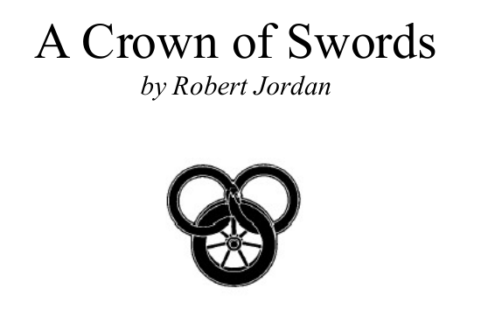
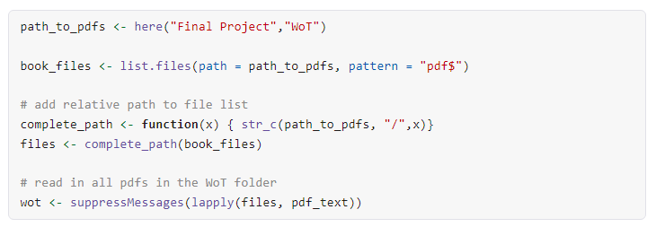
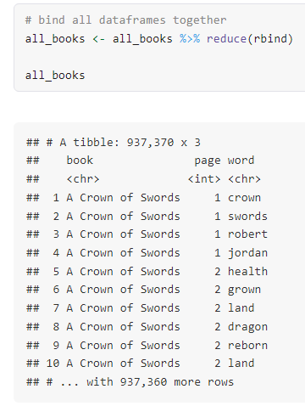
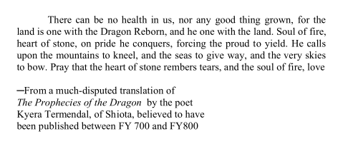
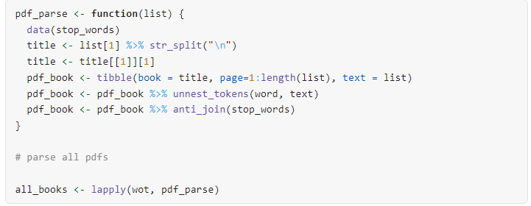
Data Collection

Slide 5
Summary Statistics
book | num_words | sentiment_stdev | sentiment_mean | sentiment_min | sentiment_max | positive | negative | goodreads_rating | num_ratings
The Eye Of The World | 10663 | 1.823 | -0.512 | -5 | 4 | 3951 | 6712 | 4.17 | 436923
The Great Hunt | 8631 | 1.854 | -0.579 | -5 | 5 | 3175 | 5456 | 4.23 | 254637
The Dragon Reborn | 8873 | 1.898 | -0.482 | -5 | 4 | 3438 | 5435 | 4.25 | 234968
The Shadow Rising | 14520 | 1.887 | -0.479 | -5 | 5 | 5513 | 9007 | 4.24 | 189853
The Fires of Heaven | 12632 | 1.892 | -0.441 | -5 | 5 | 4942 | 7690 | 4.16 | 153907
The Lord of Chaos | 14687 | 1.919 | -0.382 | -4 | 4 | 5992 | 8695 | 4.14 | 143274
A Crown of Swords | 10928 | 1.909 | -0.421 | -4 | 5 | 4371 | 6557 | 4.04 | 139194
The Path of Daggers | 8634 | 1.891 | -0.408 | -4 | 4 | 3423 | 5211 | 3.91 | 119925
Winter’s Heart | 9146 | 1.919 | -0.402 | -5 | 4 | 3619 | 5527 | 3.94 | 114984

Slide 6
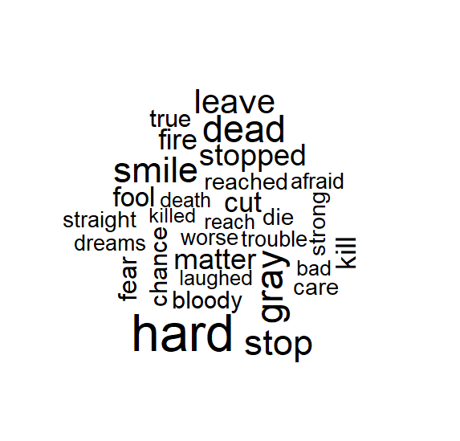
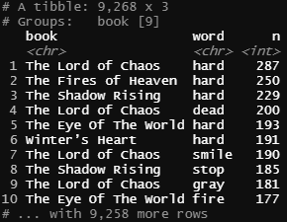
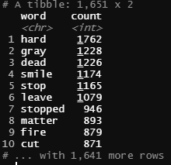
Word Distribution
Top 10 words in total by book
Top 10 words in total
Top 30 words in total

Slide 7
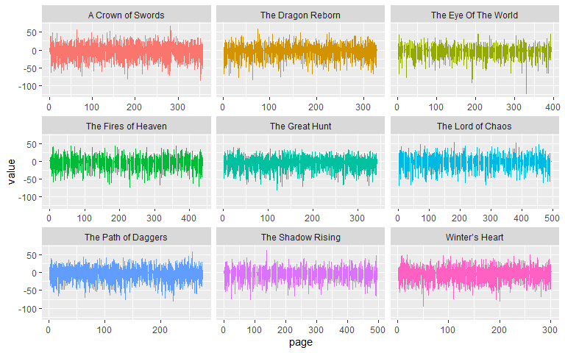
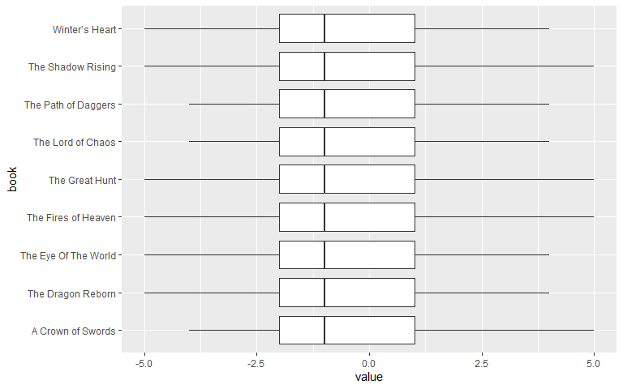
Page Sentiment Progression

Slide 8
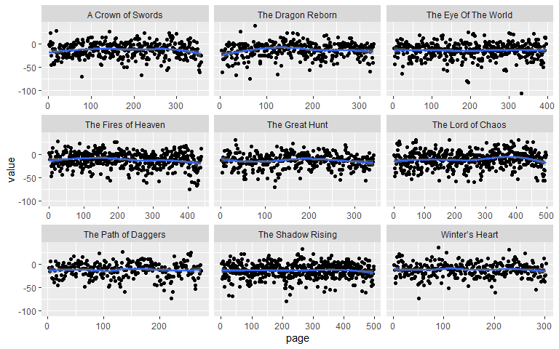
Page Sentiment Progression
Call:
## lm(formula = value ~ page, data = all_books_afinn_pages)
##
## Residuals:
## Min 1Q Median 3Q Max
## -91.968 -8.973 1.076 11.047 52.085
##
## Coefficients:
## Estimate Std. Error t value Pr(>|t|)
## (Intercept) -1.310e+01 5.285e-01 -24.787 <2e-16 ***
## page 2.074e-04 2.259e-03 0.092 0.927
## ---
## Signif. codes: 0 '***' 0.001 '**' 0.01 '*' 0.05 '.' 0.1 ' ' 1
##
## Residual standard error: 16.2 on 3419 degrees of freedom
## Multiple R-squared: 2.465e-06, Adjusted R-squared: -0.00029
## F-statistic: 0.008429 on 1 and 3419 DF, p-value: 0.9269
The linear regression model for all books shows that there is effectively no proportion of variation in sentiment value that can be attributed to a change in page number.

Slide 9
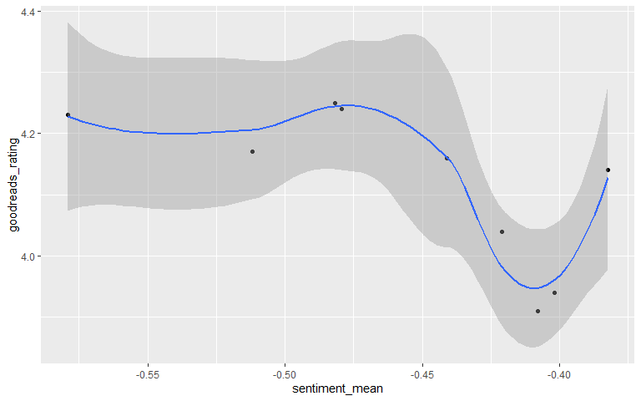
Sentiment Mean to Goodreads Rating
## Call:
## lm(formula = goodreads_rating ~ sentiment_mean, data = combined_books)
##
## Residuals:
## Min 1Q Median 3Q Max
## -0.14389 -0.05745 -0.02602 0.08840 0.12071
##
## Coefficients:
## Estimate Std. Error t value Pr(>|t|)
## (Intercept) 3.4974 0.2625 13.325 3.14e-06 ***
## sentiment_mean -1.3646 0.5705 -2.392 0.048 *
## ---
## Signif. codes: 0 '***' 0.001 '**' 0.01 '*' 0.05 '.' 0.1 ' ' 1
##
## Residual standard error: 0.1014 on 7 degrees of freedom
## Multiple R-squared: 0.4498, Adjusted R-squared: 0.3711
## F-statistic: 5.722 on 1 and 7 DF, p-value: 0.04803
The linear regression model shows that about 37% of variation in goodreads rating that can be attributed to a change in a book’s sentiment mean.

Slide 10
Conclusions
Importance
This analysis could be informative for writers hoping to gain insight into their fantasy writing. If there is a correlation between sentiment progression or sentiment mean across a series and its corresponding Goodreads rating, a writer could use that information to adjust their writing for a better rating. Unfortunately, my analysis did not yield any statistically significant results. However, I believe I could expand my analysis to other areas of sentiment analysis or take a different approach to see if that holds true.
Limitations
Lexicon / Stopwords
AFINN lexicon may not be the best for fantasy novels
I didnt analyze all the words that the stopwords dataset removed which could be relevant for analysis
Book Segmentation
I used pages when you could analyze by chapter or different sections
I used words for analysis, but you could also tokenize sentences for sentiment
Gray = -1
He had gray eyes = 0
More data
There are 6 other WoT novels which may have impacted by results through exclusion. I excluded them because the data collection process was more complicated for those PDFs I had.
Additional variables
Ratio of positive to negative
NRC Lexicon - (Angry, Sad, Happy etc.)
Impact of number of users who rated the books

Slide 11
Citation
Finn Årup Nielsen A new ANEW: Evaluation of a word list for sentiment analysis in microblogs. Proceedings of the ESWC2011 Workshop on ‘Making Sense of Microposts’: Big things come in small packages 718 in CEUR Workshop Proceedings 93-98. 2011 May. http://arxiv.org/abs/1103.2903.

